Slide 1

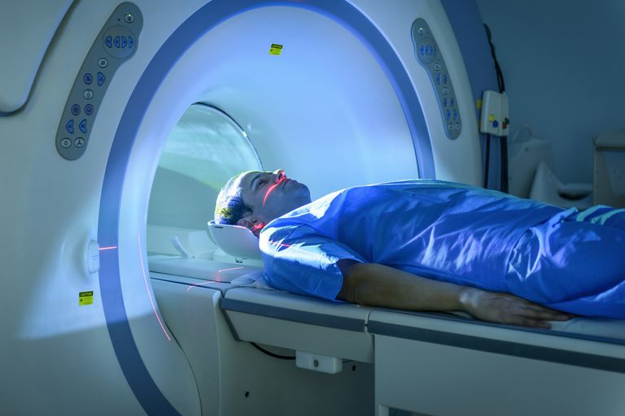
APPLICATION OF INHOMOGENEOUS MAGNETIC FIELD IN MRI
DEKEL VERED
INBAL ALON
YONI KATZIR
SAGOL SCHOOL OF NEUROSCIENCE,
DATA SCIENCE HACKATHON,
JUNE 2019
https://github.com/inbalalo/MRI_rec

Slide 2
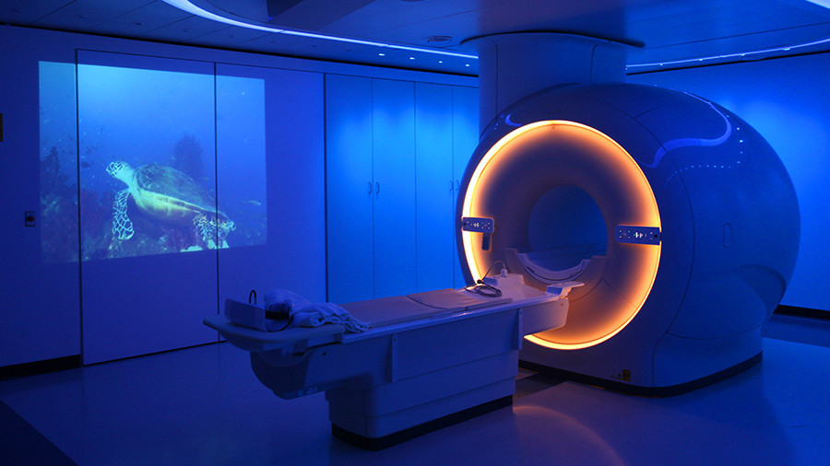
INTRODUCTION
MRI is a successful imaging tool which provides a vast amount of anatomical and functional information, which facilitate and improve diagnosis and patient treatment without harmful radiation.
However, MRI requires high costs and high maintenance costs.
Due to the costs, high weight and complex equipment, MRI is not currently accessible clinically as desired

Slide 3
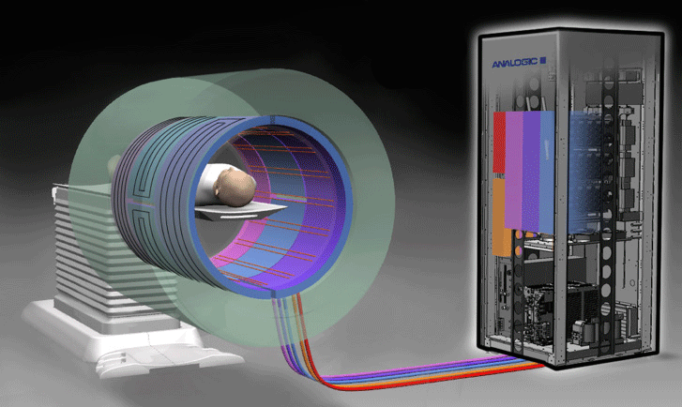
INTRO – CONT.
One of the main processes that raises the MRI costs is gaining a magnet that produces homogeneous magnetic field.
For that, heavy induced magnet is required in addition to gradient coils that add magnetic field that help us correcting the inhomogeneities and also add dependency in location, in order to reconstruct an image.

Slide 4
INTRO – CONT.
In previous work done in Prof. Uri Nevo‘s lab, simulations and computational analyzes showed a proof of concept and demonstrated theoretically and simulatively that it is possible to reconstruct data acquired:
using a magnet that produces inhomogeneous magnetic field
without gradient coils

Slide 5






PROJECT GOAL
Create an application that will help reconstructing images from non-homogeneous magnetic field
where the vision is…
HIGHLY INHOMOGENEOUS MAGNETIC FIELD
LOW INTENSITY MAGNETIC FIELD
WITHOUT GRADIENT COILS
ACCESSIBLE
CHEAP
LESS COMPLEX
Therefore, after the acquisition and the encoding of mock data, our framework is based on examining the reconstruction process using a minimalistic developed MRI. For that we will scan and examine three-dimensional objects in several scanning protocols.

Slide 6

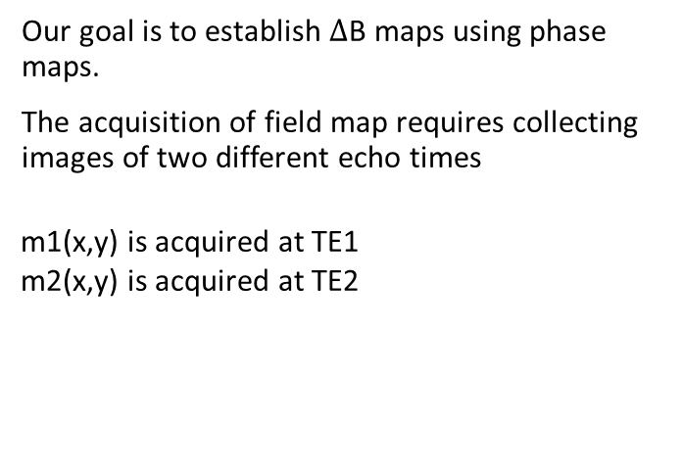


METHODS
FIELD MAPS | JOHN PAULY 2005

Slide 7


PROJECT DEMO
ALGORITHM – BLOCK DIAGRAM
Based on the previous described paper
Find ∆ by the multiplication of conj(m1) and m2)
Divide by ∆TE and Ɣ
Obtain ∆B map
Interpolation – more accurate ∆B map

Slide 8




MAJOR COMPONENTS
BACK-END
Writing efficient functions to calculate phase and field maps
GUI
The GUI allows the user to start the system, to calculate phase maps, field maps and averaged field map
FILE HANDLING
Read and write from disk
TESTING
Each and every function will be backed-up with tests.

Slide 9
BACK-END
FUNCTION EXAMPLE
def compute_phase(self, img1, img2): ''' Gets two reconstructed images and computes one phase image ''' conj_img2 = np.conj(img2) multiplic_img1_img2 = conj_img2 * img1 phase_map = np.angle(multiplic_img1_img2) return phase_map

Slide 10
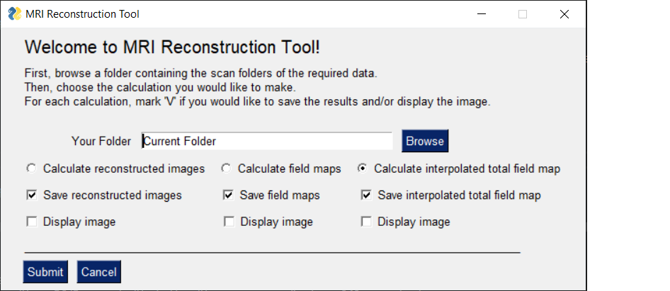
GUI
GUI ILLUSTRATIONS AND CODE SAMPLE

Slide 11
FILE HANDLING
EXAMPLE
def save_arrays_to_disk(self, path, arrays_dictionary: dict, name_prefix: str): """ Convert every numpy array in arrays_dictionary to xarray and save it in the given path as a NetCDF file. """ for key, array in arrays_dictionary.items(): # make sure to create folder if does not exist x_arr = xr.DataArray(array) file_name = name_prefix + str(key) x_arr.to_netcdf(f'{path}\\{file_name}.nc', mode='w')

Slide 12
TESTING
TEST EXAMPLE
def test_compute_phase_validate_matrix_size_suitable_for_multiplication(self):
Homogeniz_instance.compute_phase(img1,img2)
assert img1.shape[1] == img2.shape[0]

Slide 13
MAIN CHALLENGES AND DIFFICULTIES
Opening and reading files from the dataset was challenging
Synchronizing and implementing different code chunks
Testing

Slide 14
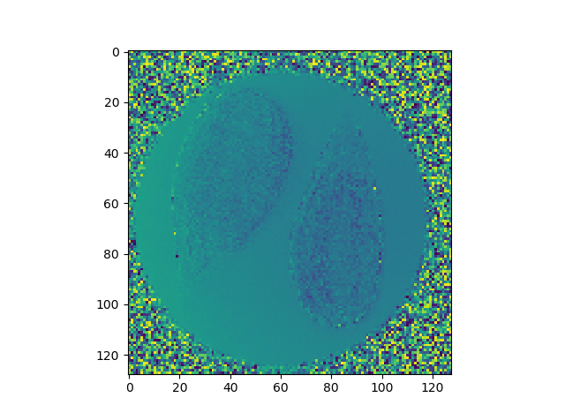
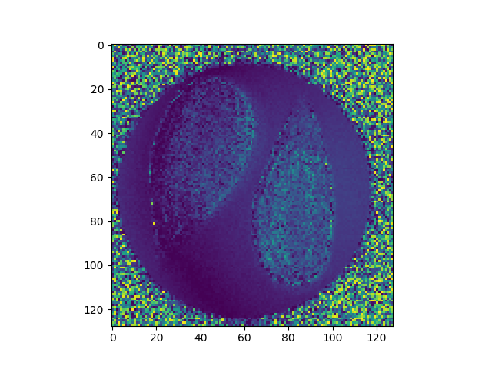
RESULTS
Field Map
Reconstructed Image

Slide 15
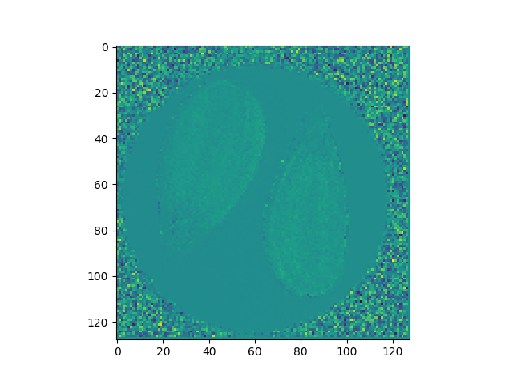
RESULTS
Averaged Field Map

Slide 16
CONCLUDING REMARKS
Is the project usable?
Yes.

Slide 17
QUESTIONS?
THANK YOU

